Slide 1
USER MANUAL
Distributor Portal

Slide 2
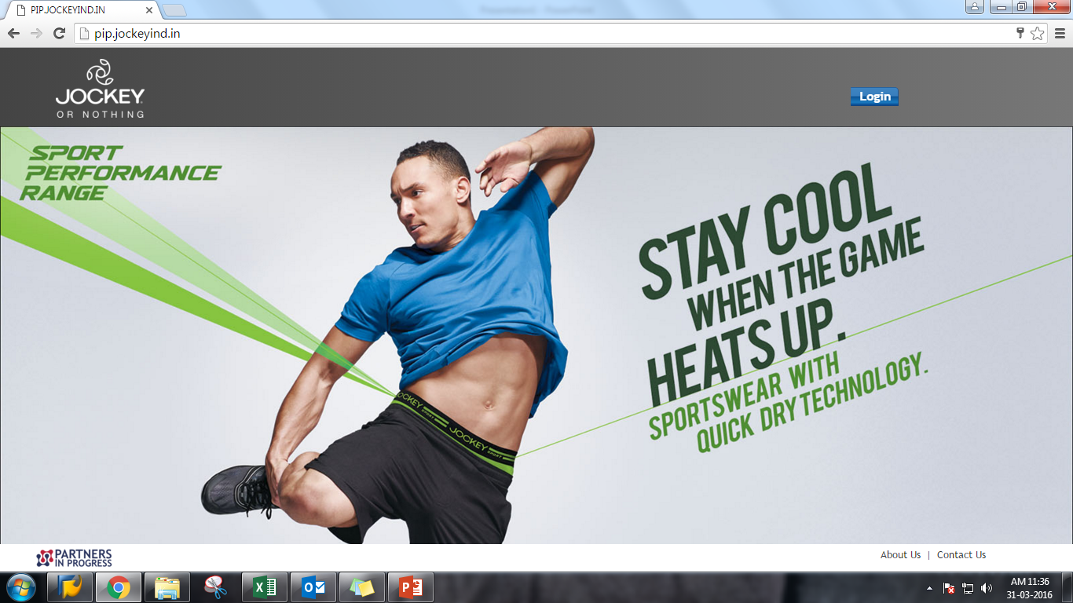
Click on login

Slide 3
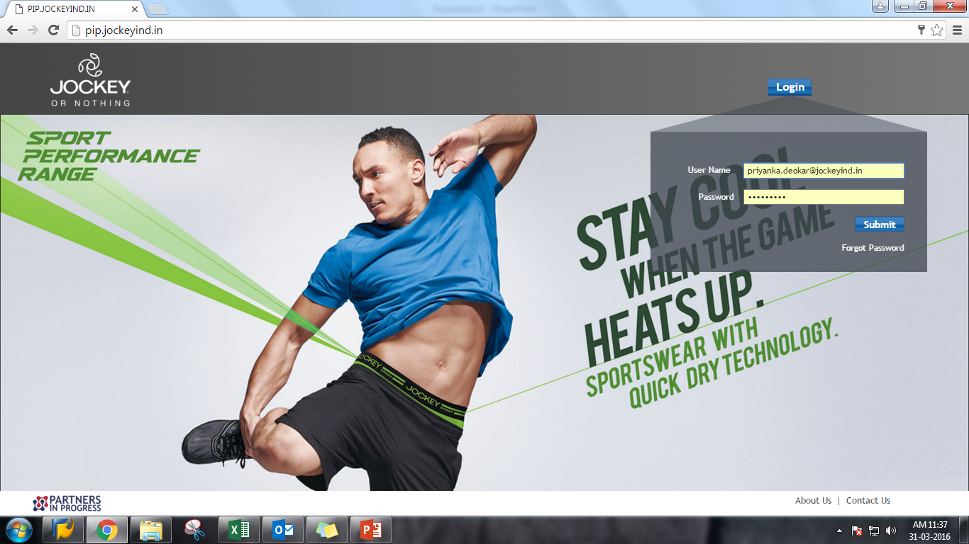
1.Give User name and Password
Click on submit

Slide 4
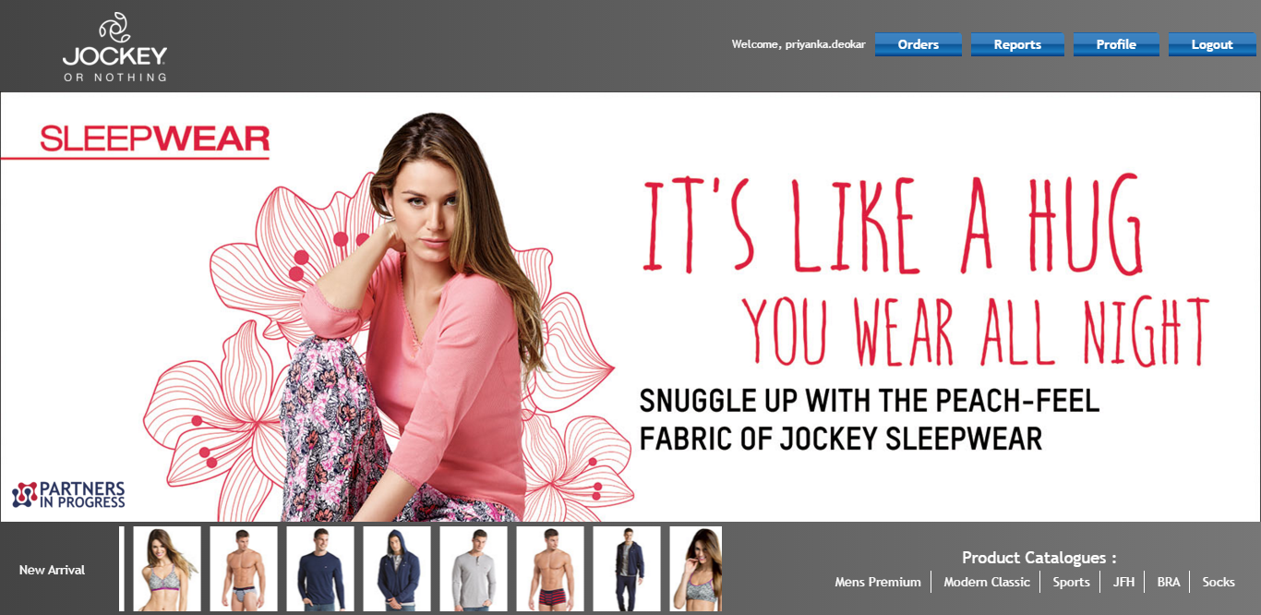
After submit this home page will display

Slide 5
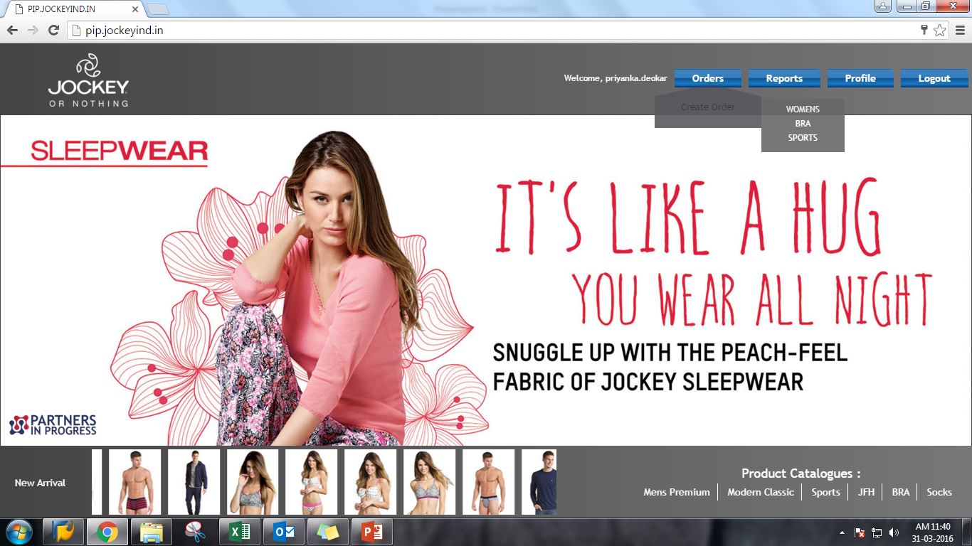
Click on Create order and choose category from list

Slide 6
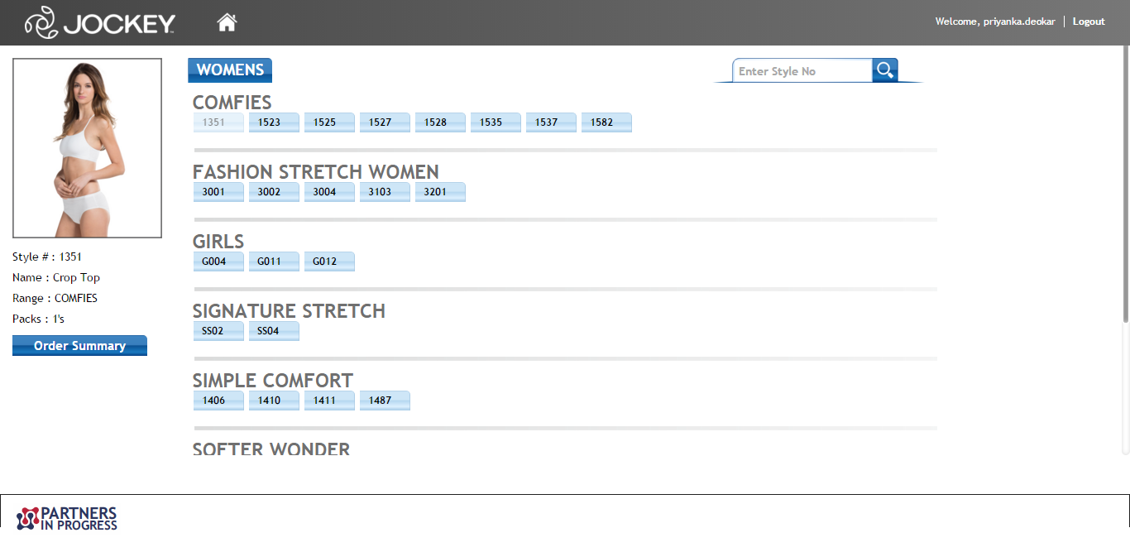
Once we choose category below page will display styles. Choose styles as per your requirement

Slide 7
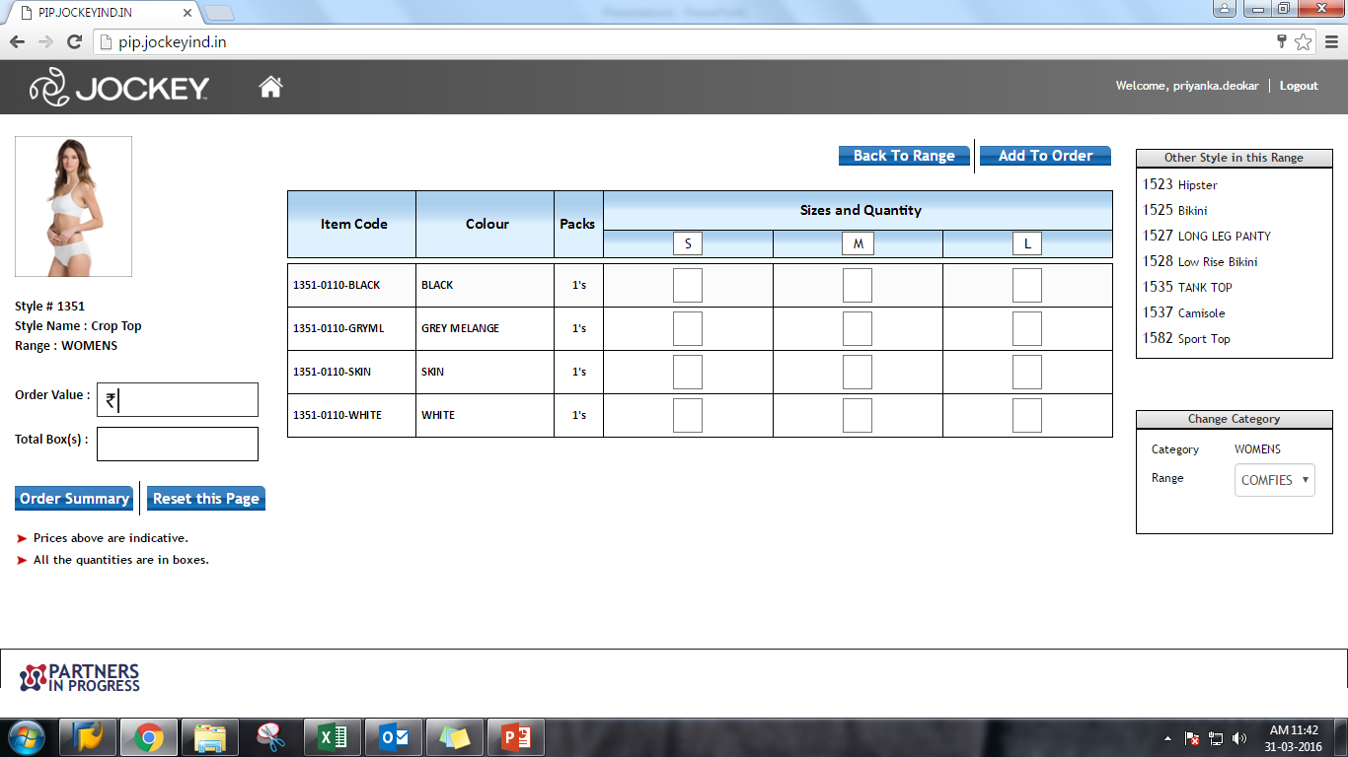
2.Always click on add to order
1.Put quantity as per size quantity as

Slide 8
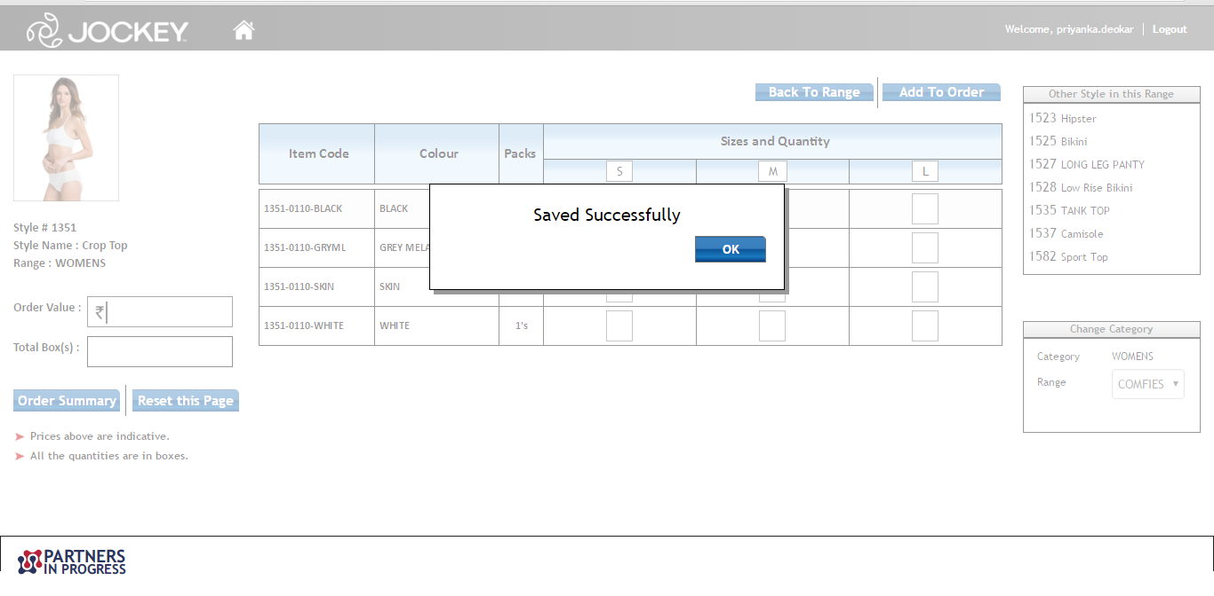
Once you click on add to order, added quantity will save for the order. Click on ok for continue

Slide 9
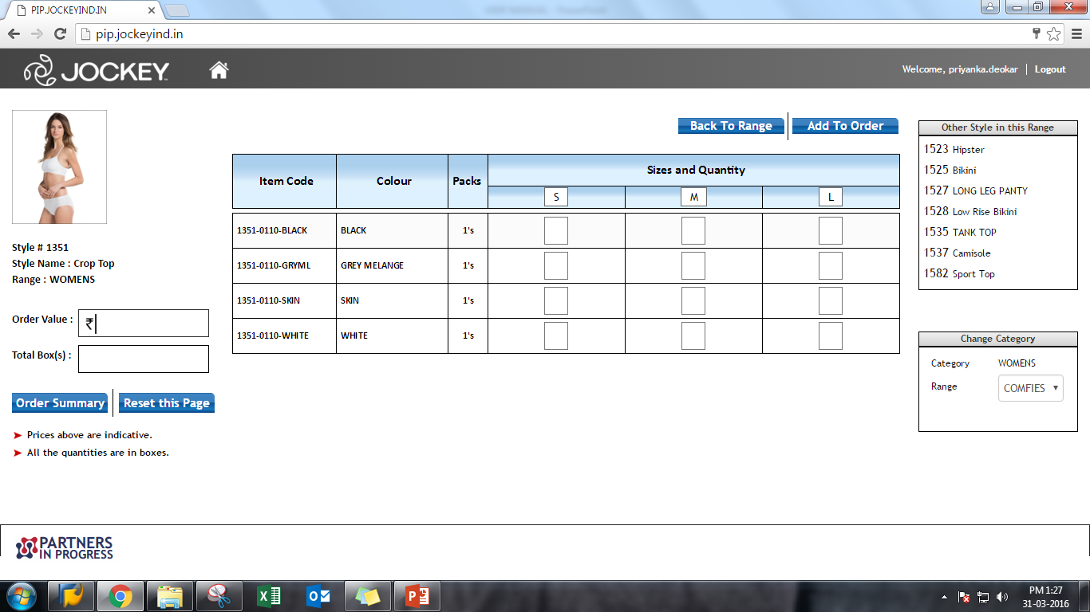
Once save order click om order summary

Slide 10
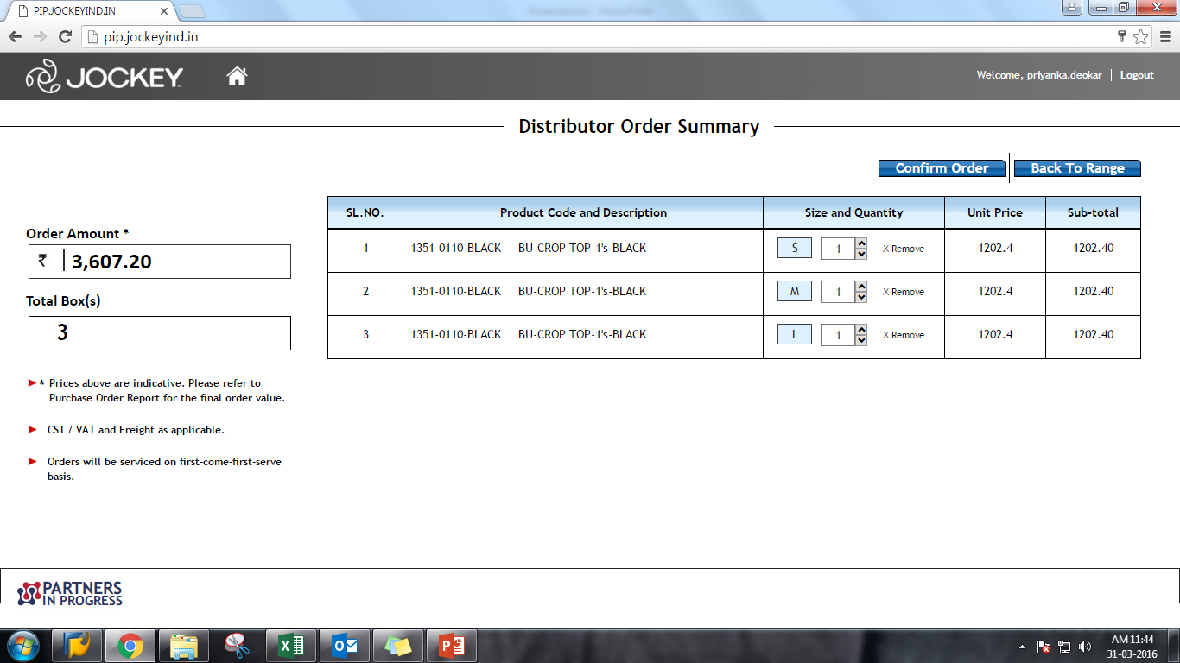
Check and click confirm orderChe

Slide 11
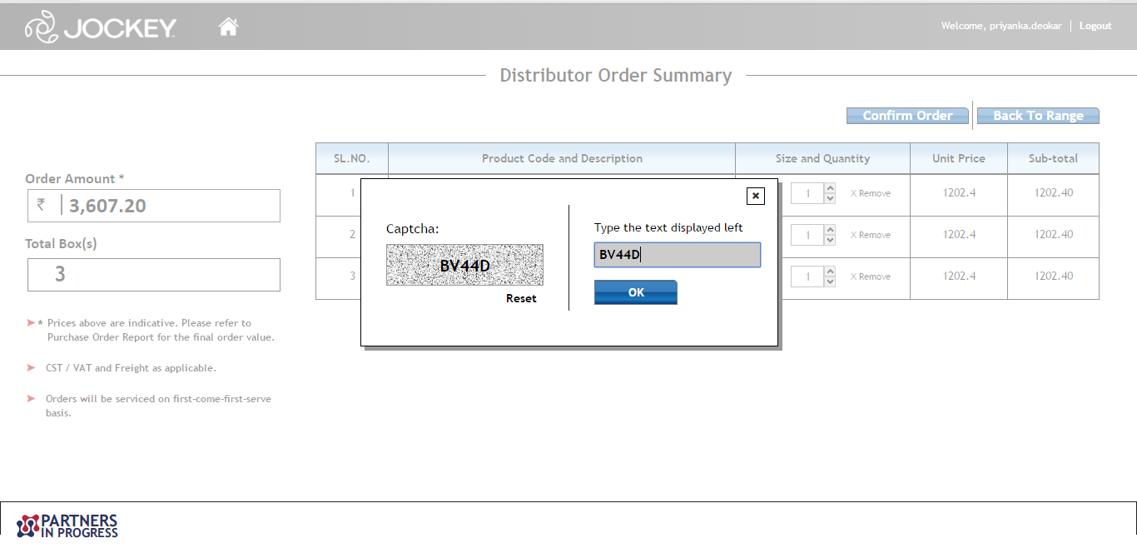
Once click on confirm order, Enter the Captcha code and click ok

Slide 12
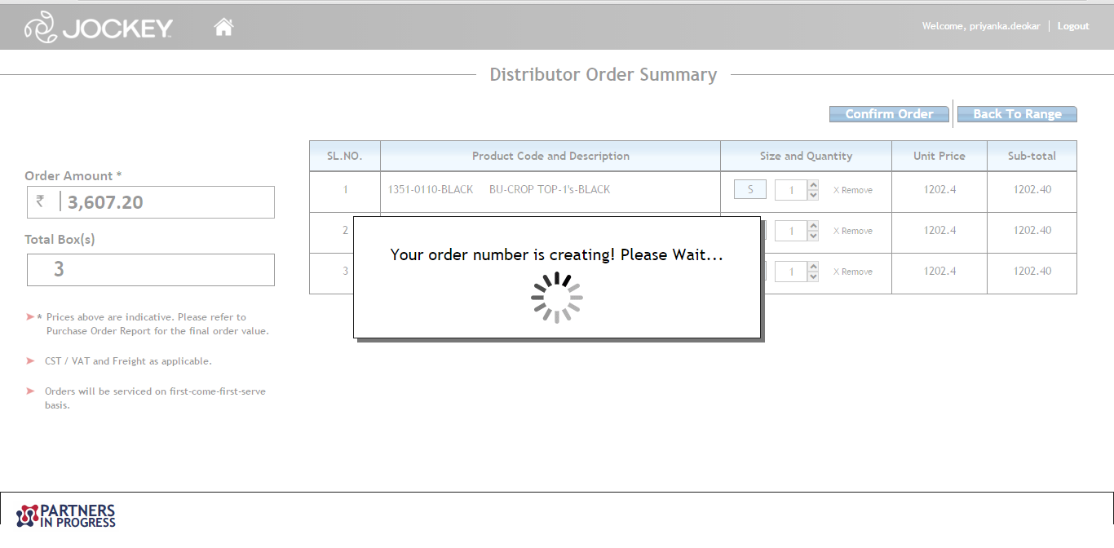
Once click on Ok, Below message will come. Wait for moment

Slide 13
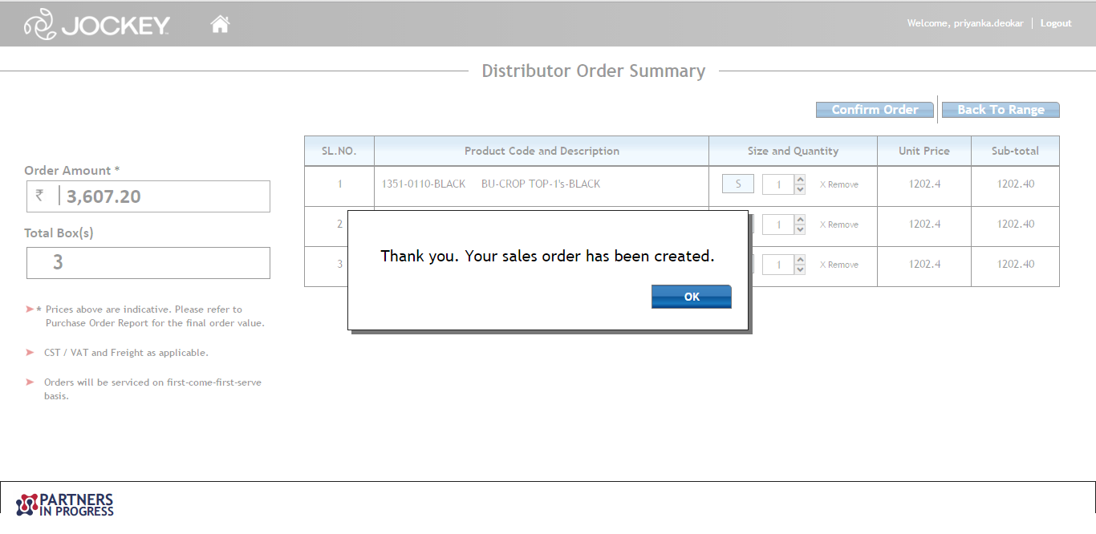
Thank you message will come. Click on Ok

Slide 14
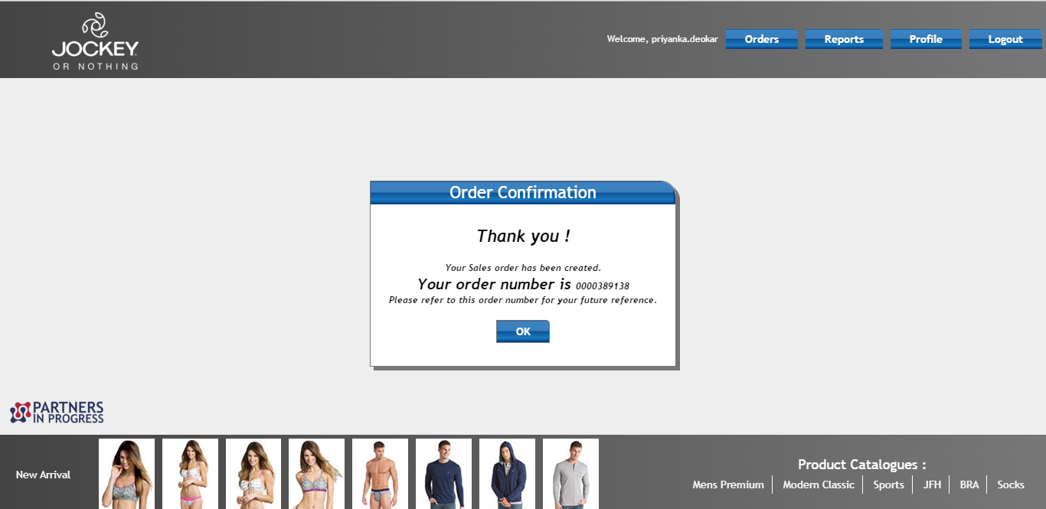
Order confirmation message will display with order number.

Slide 15
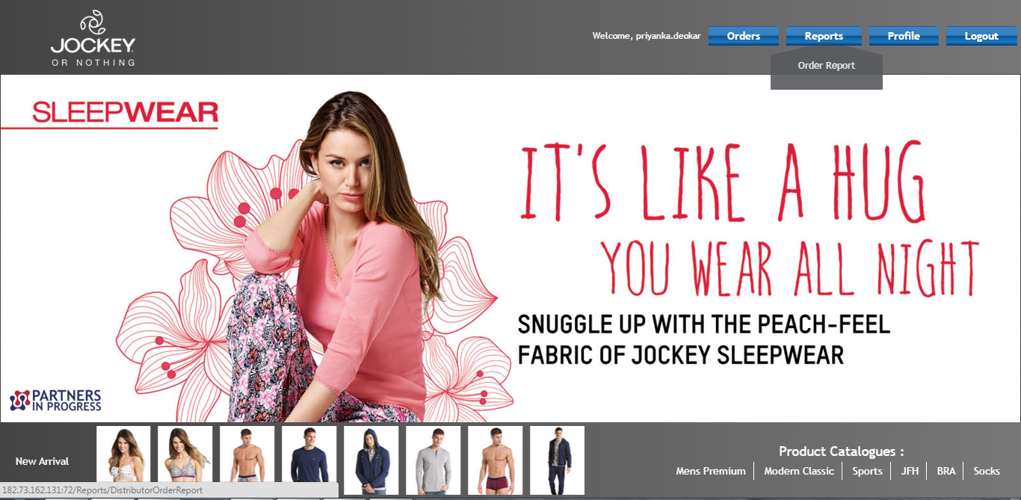
You can see order related information in report
Click on Report

Slide 16
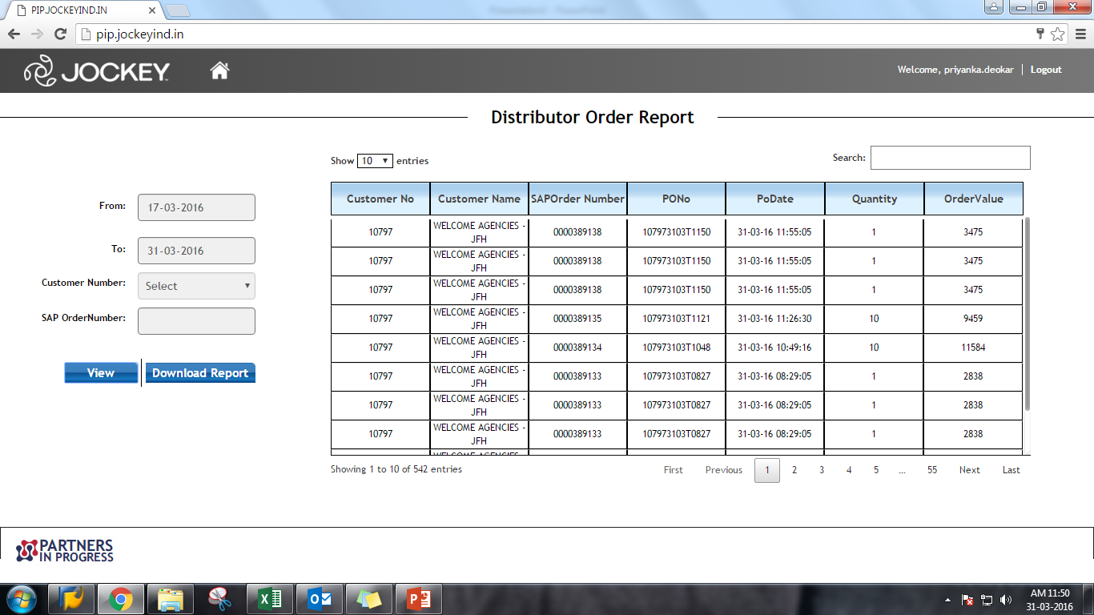
1.Give From and To date and click on view

Slide 17
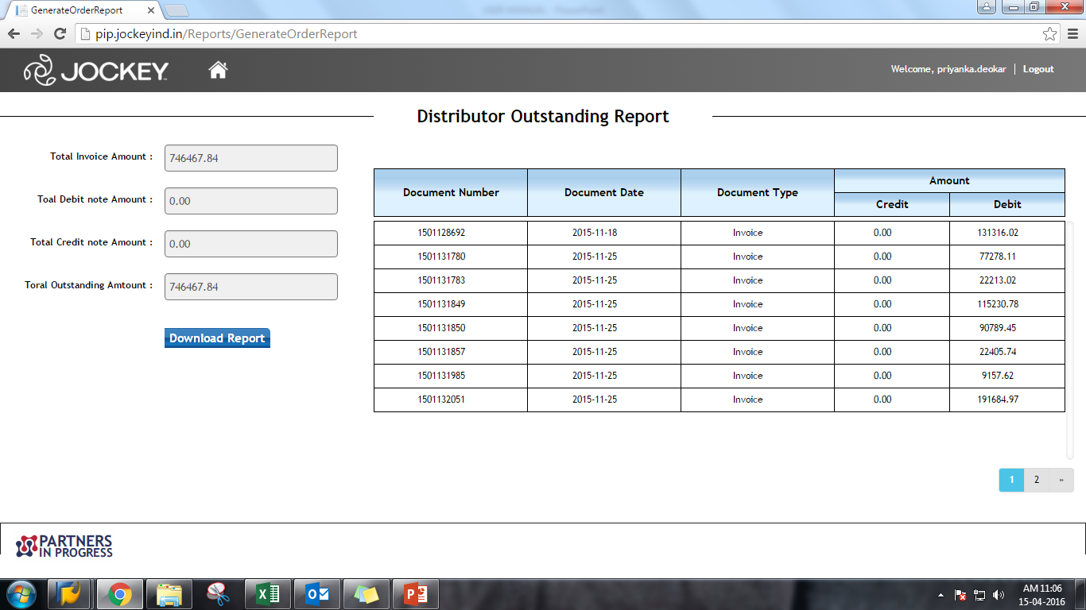
Distributor outstanding report

Slide 18
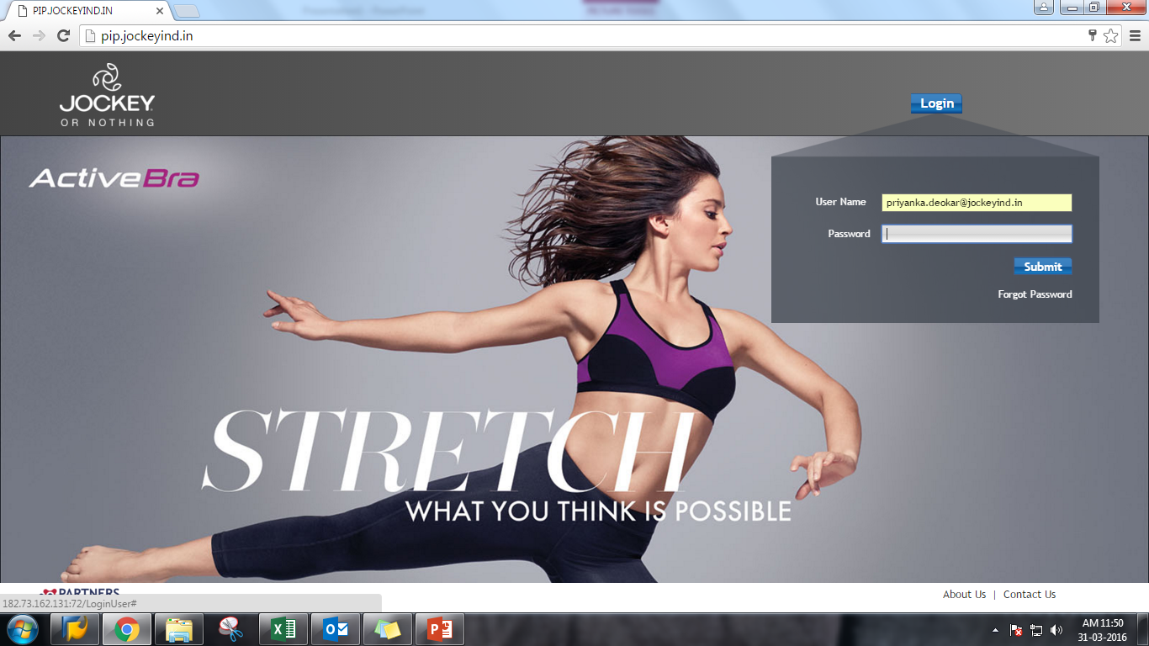
If forgot your password, Click on forgot password

Slide 19
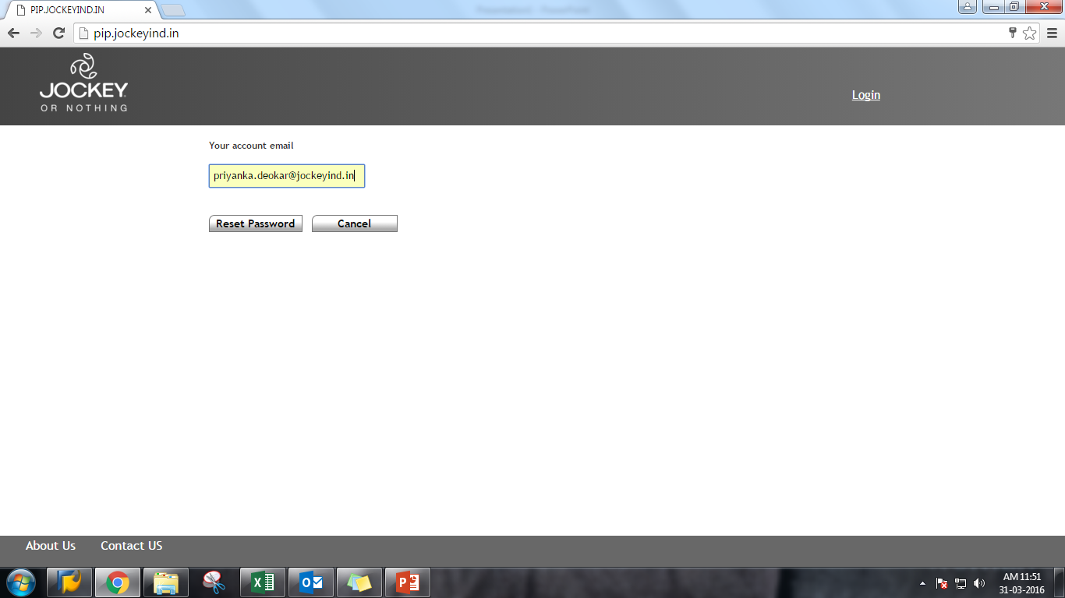
Give E-mail ID and Click on reset password

Slide 20
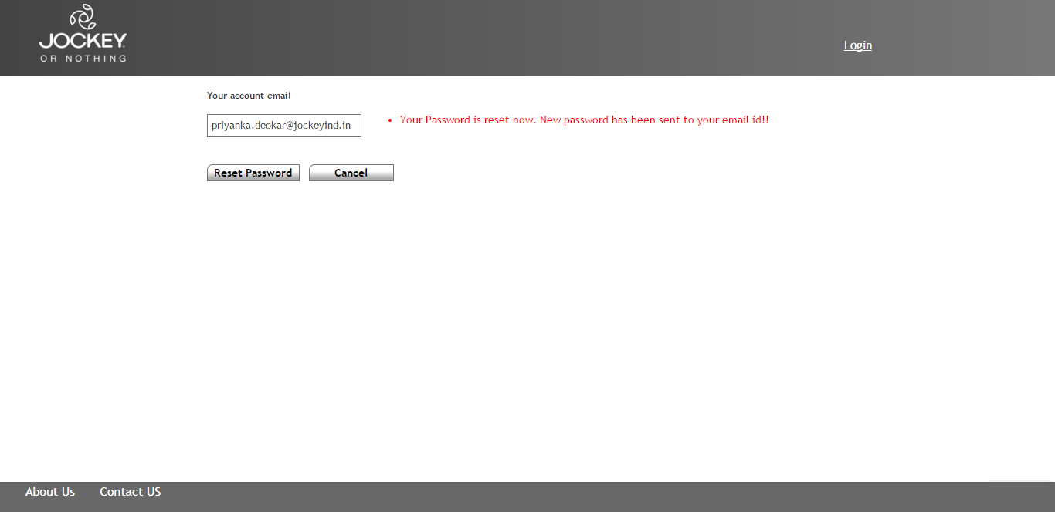
Once click on reset password, successful messae will come. E-mail will sent on your mail id

Slide 21
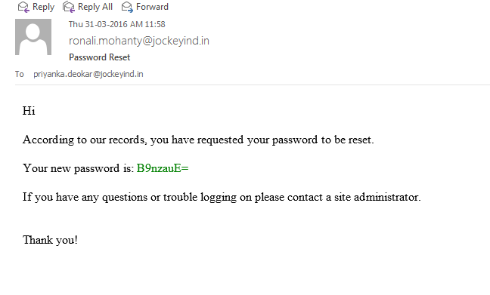
You will get E-mail for new password, copy new password.

Slide 22

Copy password here and submit

Slide 23
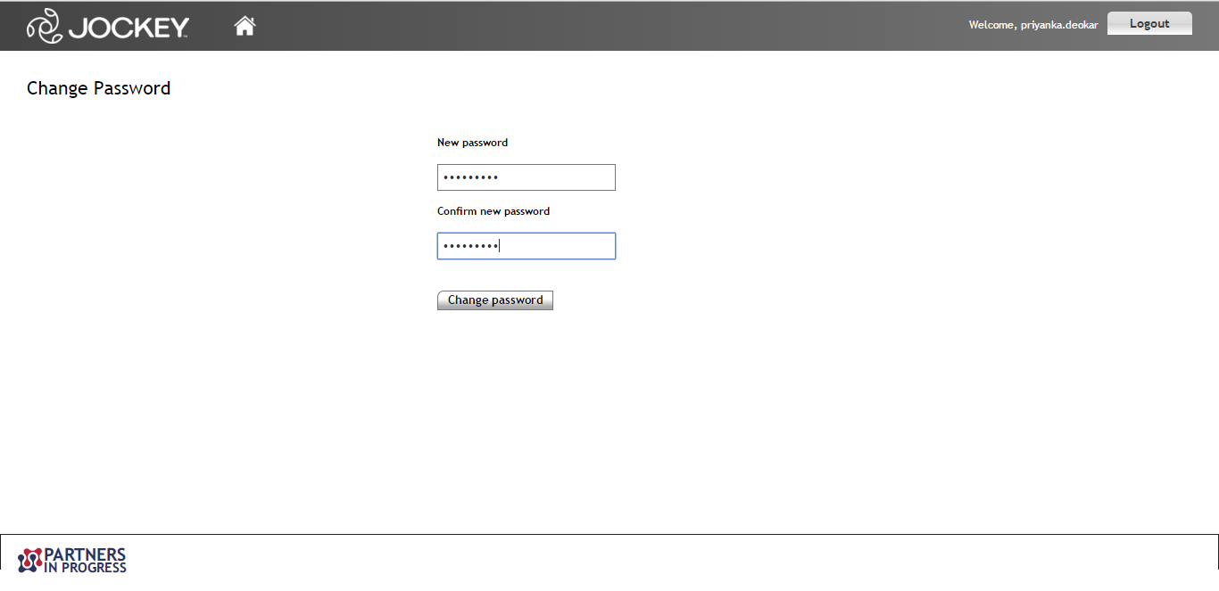
Once submit, Change password page will open. You have to give new password and click on change password.

Slide 24
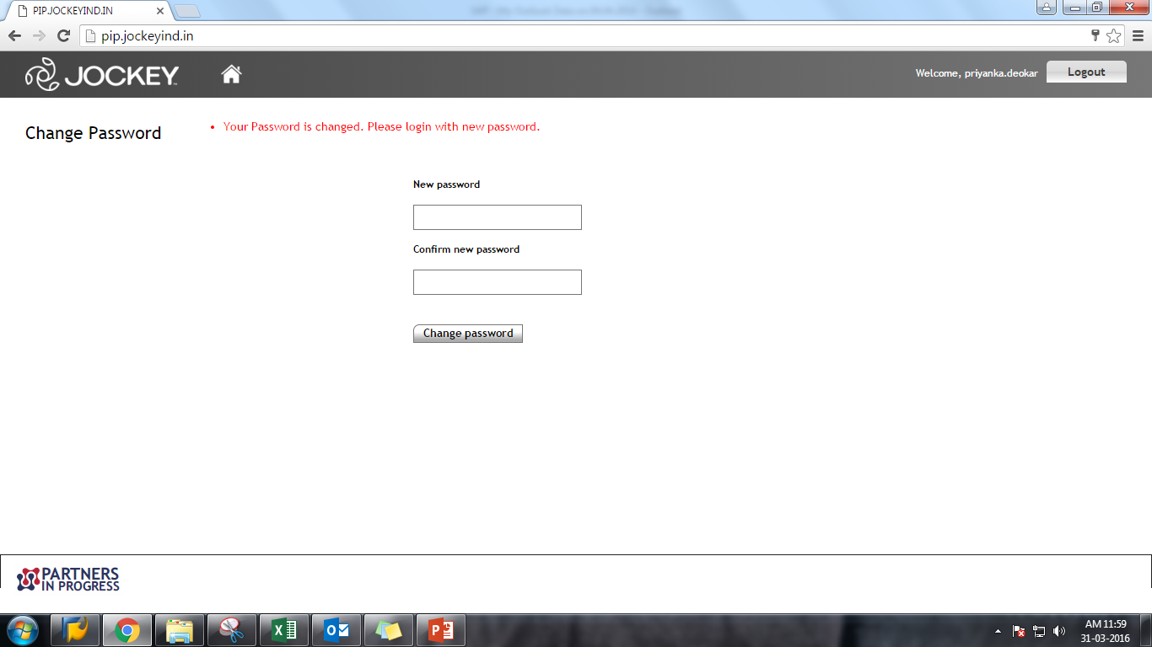
Your New password will be reset.

Slide 25
Thank You
------Priyanka

